Slide 1

Call Centre Analysis
File created on: 8/27/2023 6:08:02 PM

Slide 2
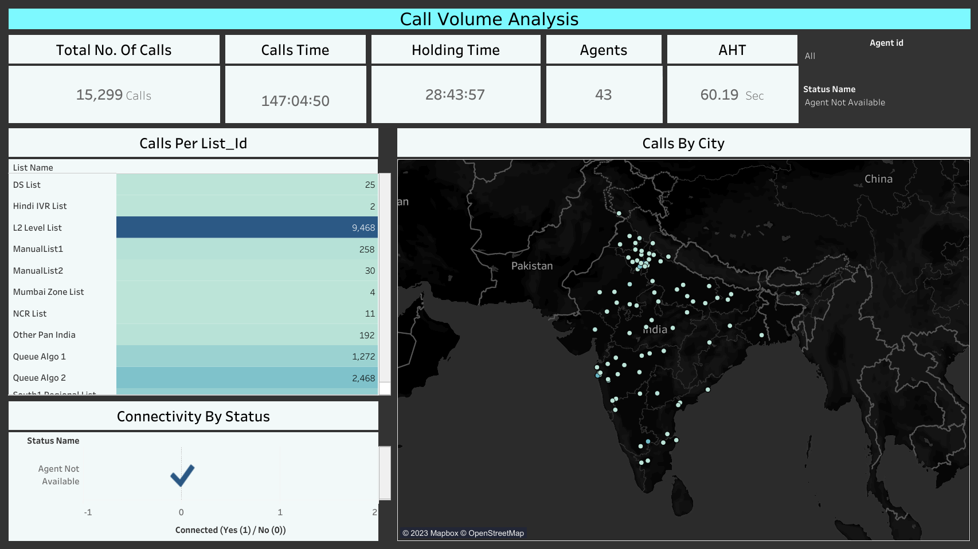

Slide 3
Call Volume analysis
Total no. of calls for the dates 18th May and 26th May is 15,299 calls.
The total Talk Time is 147 hours 04 minutes and 50 seconds.
The total Hold Time is 28 hours 43 minutes 57 seconds.
Maximum no. of calls by List were made to L2 Level List with 9,468 calls.
Maximum no. of calls were made to the city New Delhi with 4,770 calls.
The calls which were not connected; they were of “Agent not available”, “No answer autodial” and “Temporary, number closed” types.

Slide 4
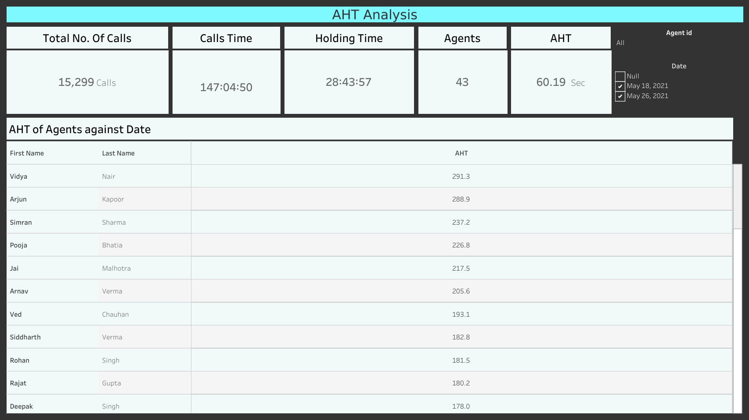

Slide 5
Average Handling Time Analysis
The calculation part is
AHT= (Talk Time + Hold Time) / Number of Customer Conversations(Calls)
Average AHT for all the agents is 60.19 seconds.
The agent with the highest AHT is Vidya Nair with 291.3 Sec’s.
The agent with the lowest AHT is Abhinav Sharma with 51.8 Sec’s.

Slide 6
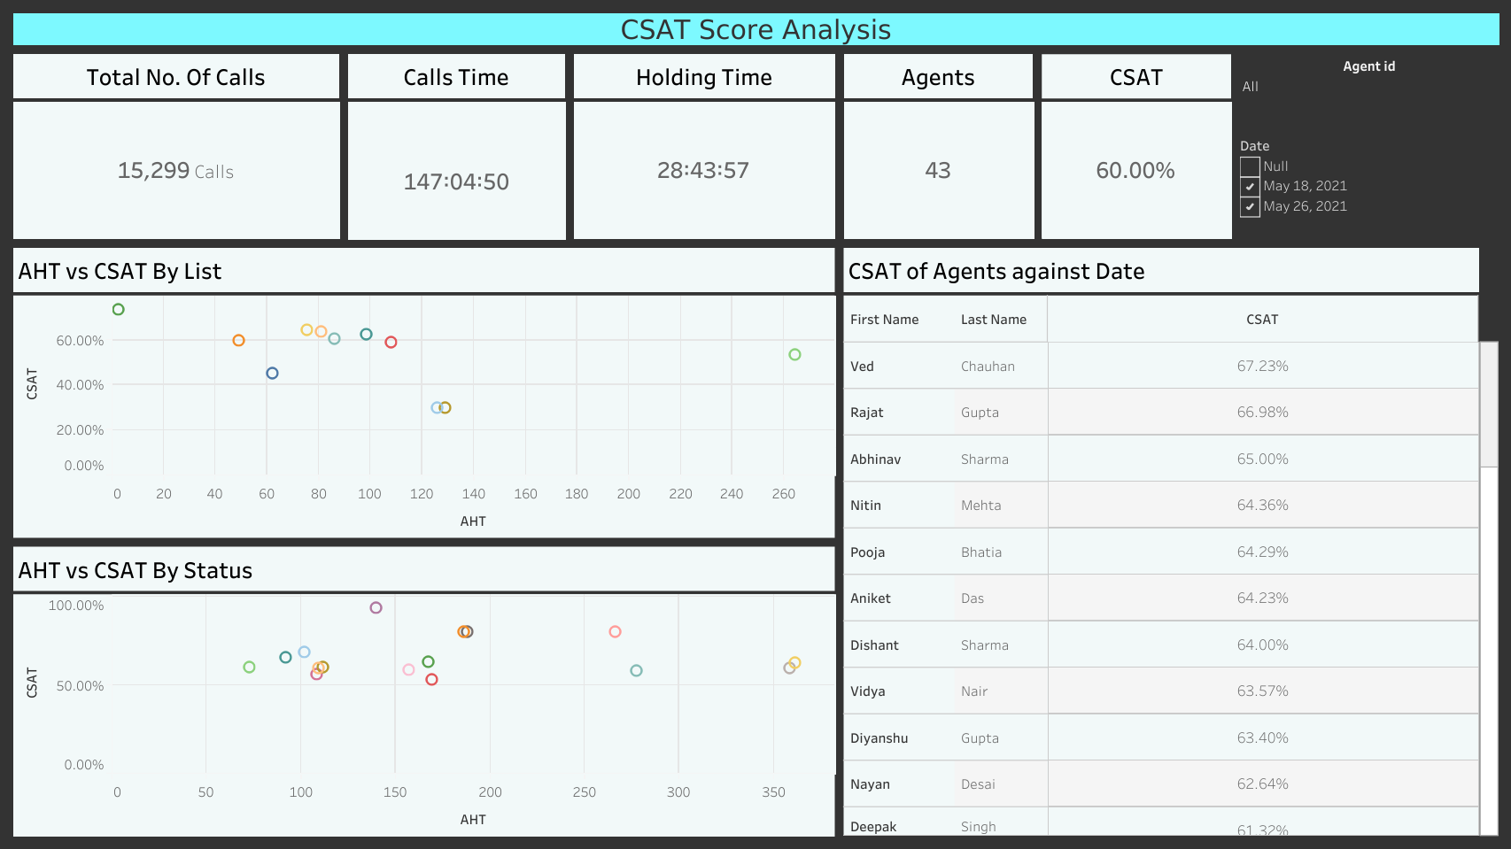

Slide 7
Customer satisfaction score analysis
The calculation part is
CSAT= ((Sum of all Satisfaction Rating / No. of Ratings)/5)*100
Average CSAT for all the agents is 60%.
The agent with the highest CSAT is Ved Chauhan with 67.23%.
The agent with the lowest CSAT is Siddharth Verma with 57.04%.
CSAT vs AHT By List has an outlier which is Mumbai Zone List with AHT of 264.3 Sec and CSAT of 53.33%.

Slide 8
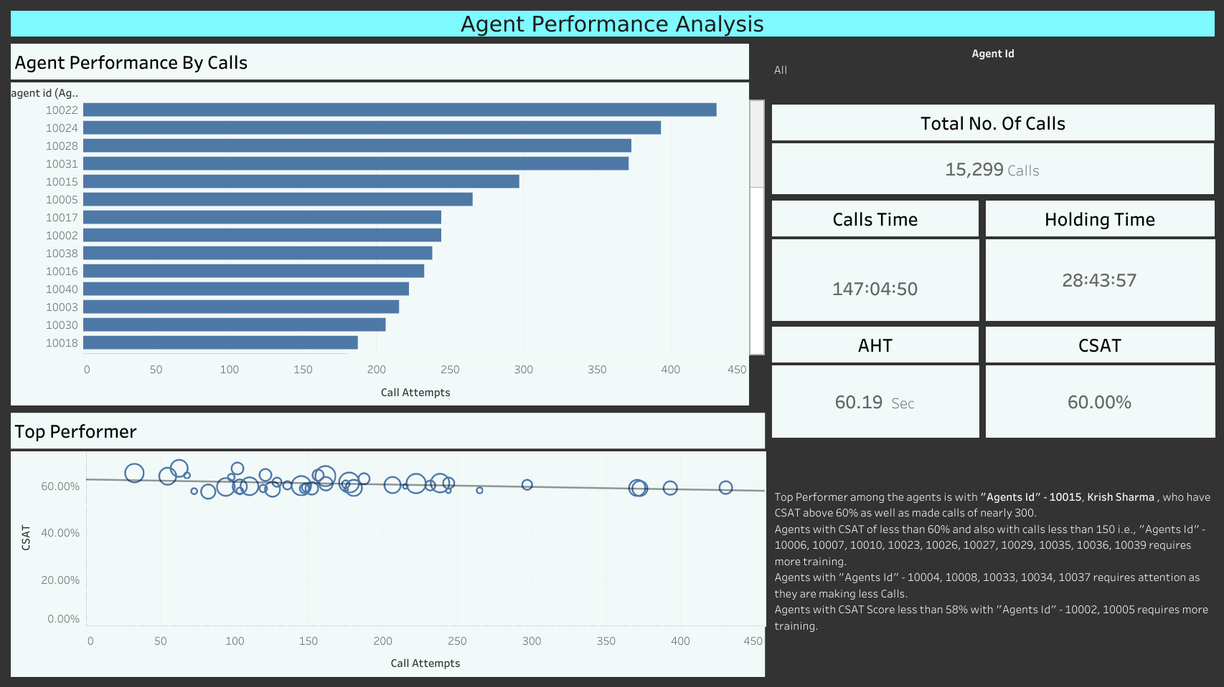

Slide 9
Agent Performance Analysis
Top Performer among the agents is with "Agents Id" - 10015, Krish Sharma , who have CSAT above 60% as well as made calls of nearly 300.
Agents with CSAT of less than 60% and also with calls less than 150 i.e., "Agents Id" - 10006, 10007, 10010, 10023, 10026, 10027, 10029, 10035, 10036, 10039 requires more training.
Agents with "Agents Id" - 10004, 10008, 10033, 10034, 10037 requires attention as they are making less Calls.
Agents with CSAT Score less than 58% with "Agents Id" - 10002, 10005 requires more training.

